Slide 1
IT Development Activity & Performance Analysis
An interactive Power bi dashboard for developer, workload & project Performance
Annmi Sunny
Data Science
April-2026

Slide 2
Problem Statement
IT development teams generate a large amount of activity and performance data but analysing this data manually can make it difficult to identify productivity trends, workload issues, burnout risks, and project performance.
A centralised and interactive dashboard is needed to transform this data into meaningful insights that support effective monitoring and decision-making.

Slide 3
About the Dataset
The dataset contains IT Development activity and performance records.
It captures information about developers, teams, projects and development activities.
The dataset includes performance – related measures such as work hours, productivity score and completion rate.
It also contains information used to analyse workload and burnout risk.
The data can be analysed across developers, teams, project and time periods.
The dataset was prepared and modelled in Power BI to create an interactive performance dashboard.

Slide 4
Data Model
The data model follows a Star Scheme, with a central Development Activity / Performance fact table.
The Development Activity table is the main fact table.
It is connected to Developer, Project, Team, and Date tables.
The model helps analyse productivity, workload, completion rate and burnout.
It makes filtering and dashboard analysis easier.

Slide 5
Relationship & Cardinality
Relationship
Cardinality
Developer → Development Activity
Project → Development Activity
Team → Development Activity
Date → Development Activity
1 : Many (1:*)
1 : Many (1:*)
1 : Many (1:*)
1 : Many (1:*)

Slide 6
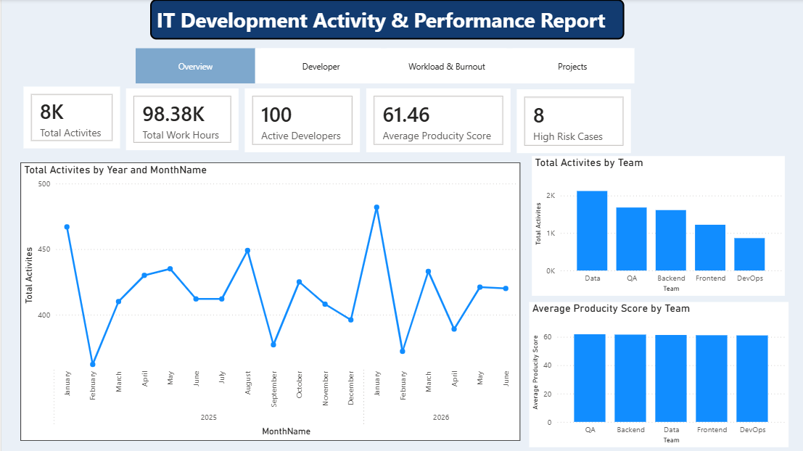
Dashboard Overview
Key Features
Overall development activity monitoring.
Team-level activity comparison.
Productivity performance analysis.
Year/month activity trends.
High-level KPI monitoring

Slide 7
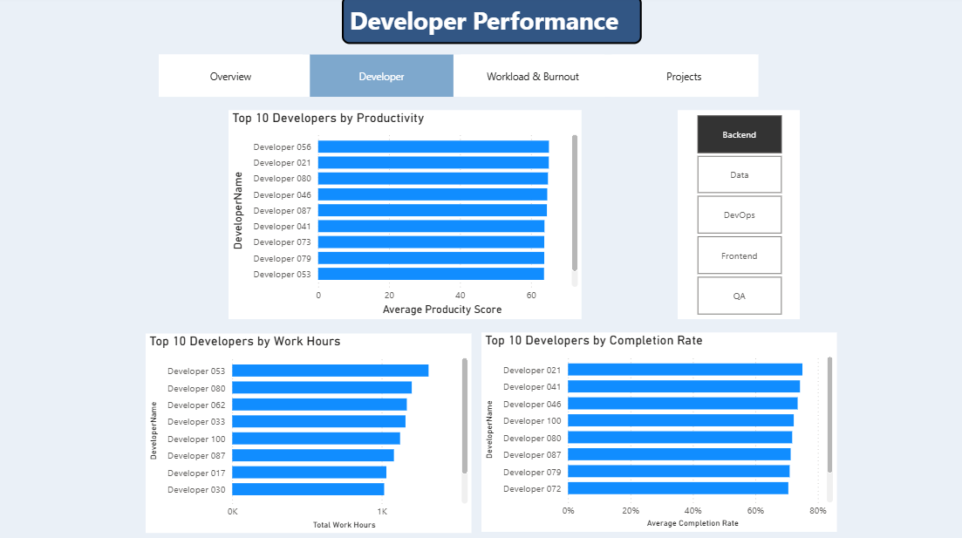
Developer Performance
Key Features
Identifies top-performing developers.
Compares developer productivity.
Analyzes developer work hours.
Compares completion rates.
Allows team-based filtering.

Slide 8
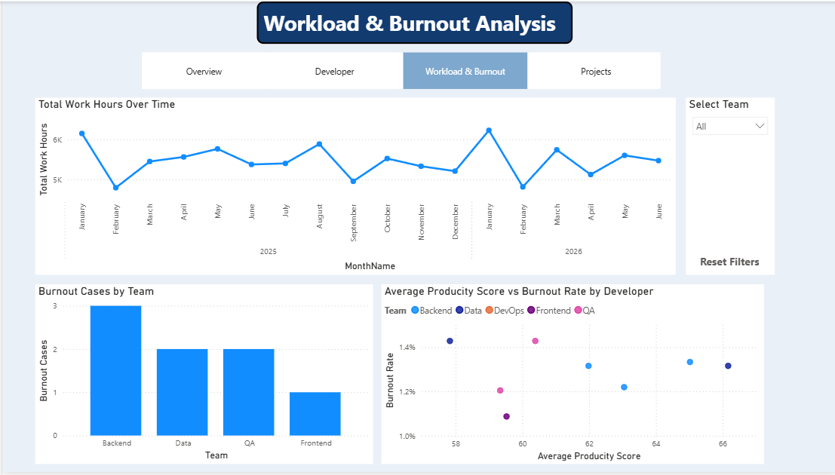
Workload & Burnout
Key Features
Tracks total work hours over time.
Compares burnout cases across teams.
Examines productivity against burnout rate.
Helps identify workload-related performance patterns.

Slide 9
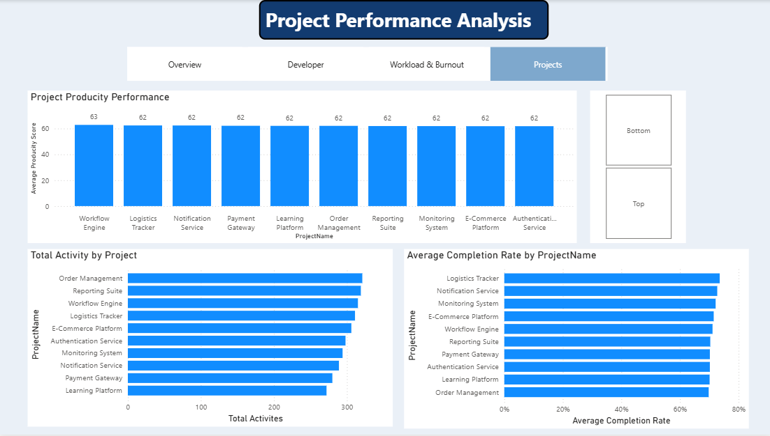
Project Performance
Key Features
Compares project activity.
Analyzes project productivity.
Evaluates project productivity.
Supports project-level performance comparison.
Provides interactive project filtering

Slide 10
Key Insights
Productivity : Productivity varies across developers and teams.
Workload : Work hours differ between developers, helping identify workload imbalances.
Project Performance : Completion rates vary across projects.
Burnout : Higher workload can be associated with increased burnout risk.
Performance Comparison : The dashboard makes it easy to compare developers and teams.
Overall : The dashboard provides a clear view of productivity, workload, project completion, and burnout for better decision-making.

Slide 11
Recommendations
Balance workloads to avoid excessive work hours and reduce burnout risk.
Monitor productivity regularly to identify performance changes early.
Support developers with high workloads through better task distribution.
Improve project planning to maintain better completion rates.
Use the Poer BI dashboard regularly to track performance and make data-driven decisions.

Slide 12
Where This Project Can Be Used
IT Companies : To monitor developer productivity and workload
Software Development Teams : To track project progress and completion.
Project Management : To identify delays and improve resource allocation.
HR Departments : To monitor workload and potential burnout risks.
Team Managers : To compare team performance and make better decisions.
Management : To use data-driven insights for planning and performance improvement.

Slide 13
Applications
Developer Performance Monitoring
Workload and Burnout Management
Project Progress Tracking
Team Performance Analysis
Resource Allocation
Data-Driven Decision Making

Slide 14
Conclusion
The Power BI dashboard provides a clear and interactive view of IT development performance.
It helps analyse productivity, workload, project completion, and burnout.
The dashboard makes it easier to compare developers, teams and projects.
Interactive slicers, navigation, and bookmarks improve the user experience.
The insights can support better planning, workload management and data-driven decision-making.
Overall the project transforms raw data into meaningful and actionable information.

Slide 15
THANK YOU

